Slide 1
Title
Detection of Money Laundering in Cryptocurrency Based on Blockchain
Ali Abrar Al Haque
Narayan Ranjan Chakraborty / NRC
Assistant Professor
Dept. of CSE,
Daffodil International University

Slide 2


Motivation:

Slide 3
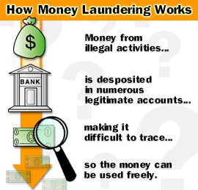
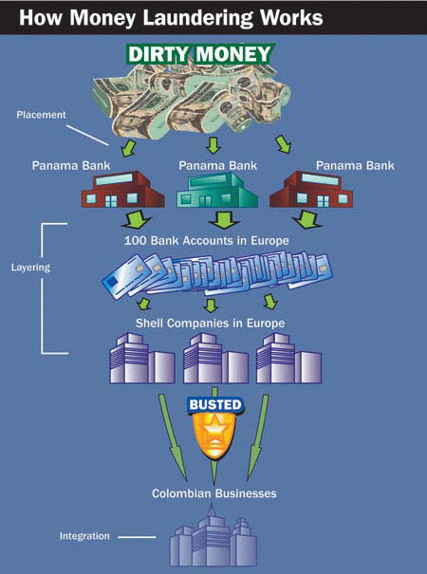
Motivation:

Slide 4


Motivation:
Terrorist’s Fundraising
Extortion
Drug Trafficking
Proliferation Weapon
Tax Evasion

Slide 5
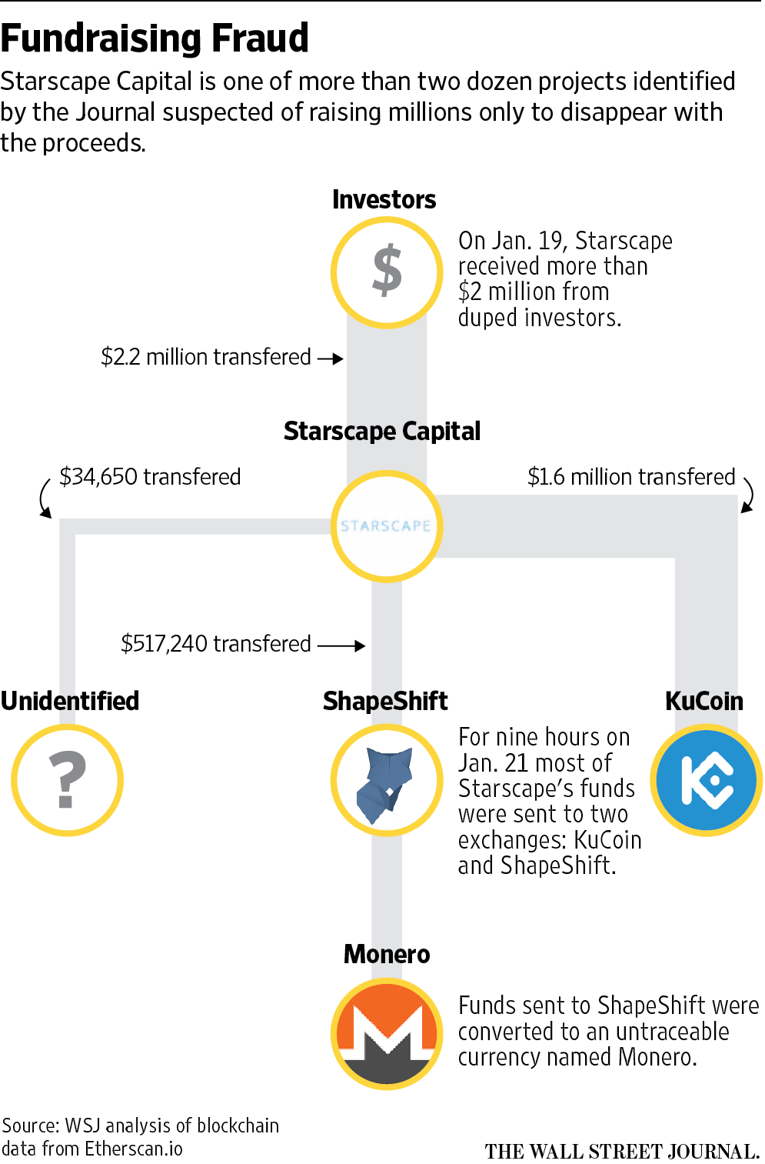
Motivation:

Slide 6


Project Type:
It is basically a Research Based Project and our Research area is “ Blockchain and Money Laundering along with Machine Learning‘’.

Slide 7

Objectives:
We are going to detect money laundering in cryptocurrency by,
Analyzing the activity data set related to transactions within the network of specified Cryptocurrency;
Reducing the number of false reports with a view to minimizing the hassles of the users, organizations and government by an efficient machine learning approach;
Informing suspicious activity report (SAR) to the government / organization.

Slide 8

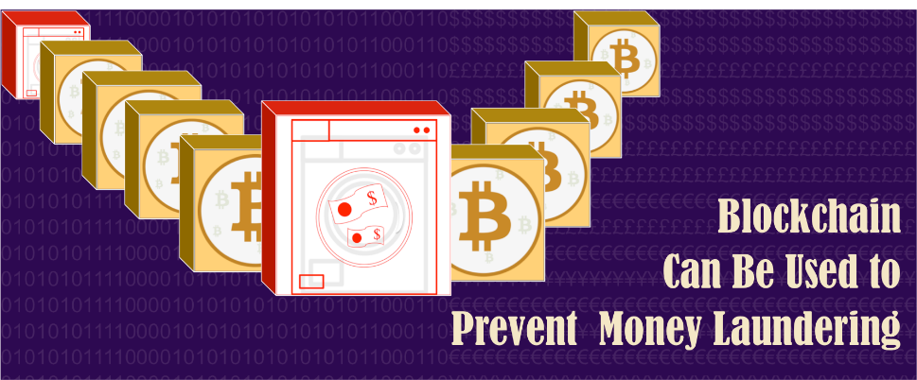
Expected Outcomes:
Introducing an Anti-Money Laundering (AML) platform, specialized for cryptocurrency;
Suspicious criminal activities would be traced and unmasked;
Economic stability would be sustained;
Money laundering would be minimized.

Slide 9
How it works?
Essential Tools:
Blockchain Environment (For transactions)
Know Your Customer (KYC)
Suspicious Pattern Recognition
(Using Machine Learning for analysis)
4. Data Sets (Activities related to transactions)

Slide 10
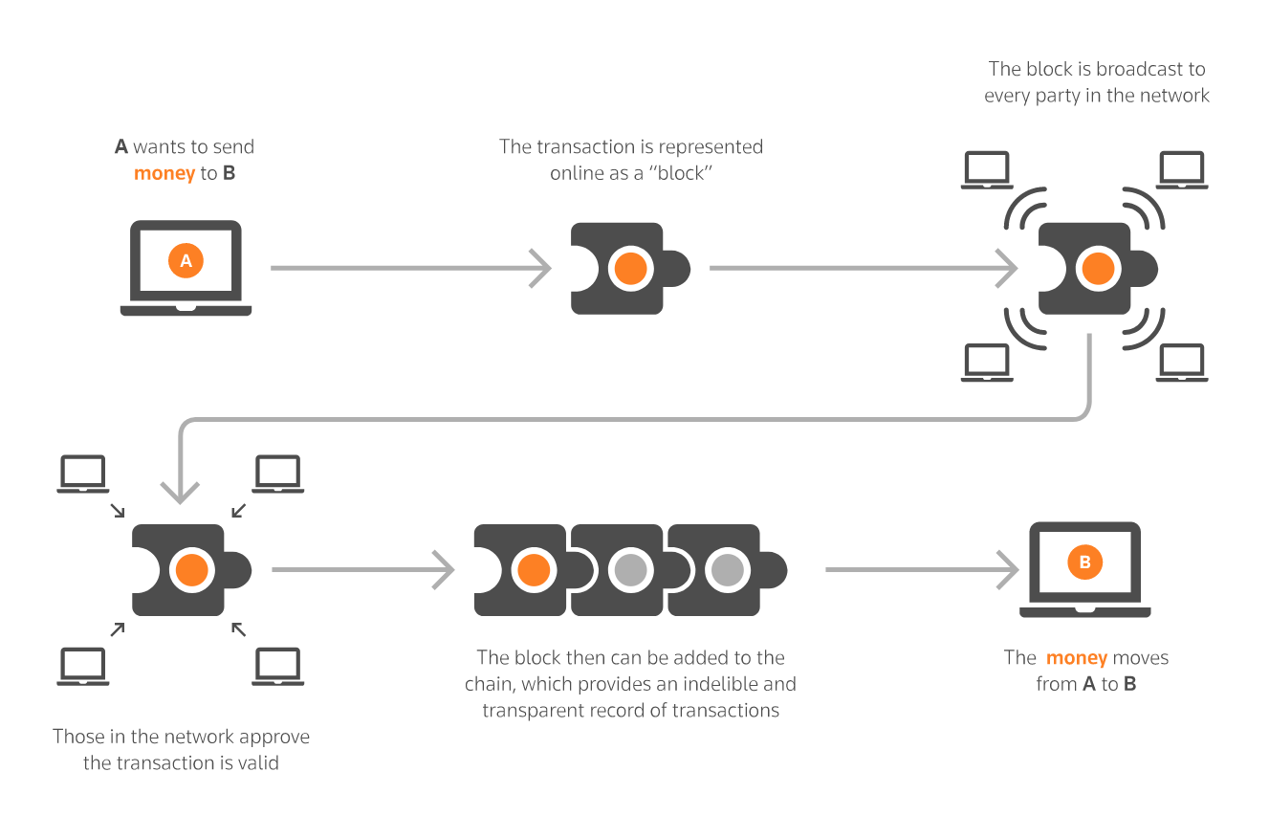
Cryptocurrency Network:

Slide 11

Know Your Customer (KYC):
If someone open an account far from their place of business or residents for purposes that are not clear,
the challenge is to monitor the transaction activities and look for common patterns of money laundering.

Slide 12

Suspicious Pattern Recognition:
Unusually Large Cash Transactions
High Volume of smaller transactions
with no specific purposes
3. Numerous transaction among the
nodes.
4. High Risk Locations (Tax Havens)

Slide 13
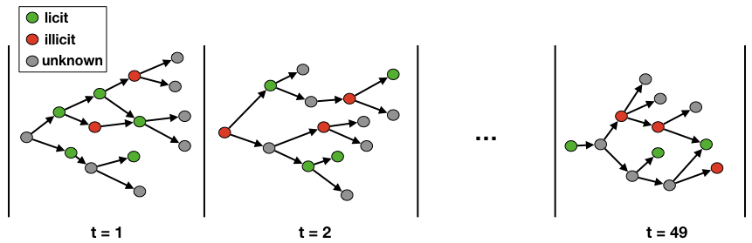
Data Sets:
Data set has opened up machine learning on the Blockchain. It is a sub-graph of the bitcoin graph where the nodes represent transactions and the edges represent the flow of bitcoins between one transaction and the other.

Slide 14


